Slide 1
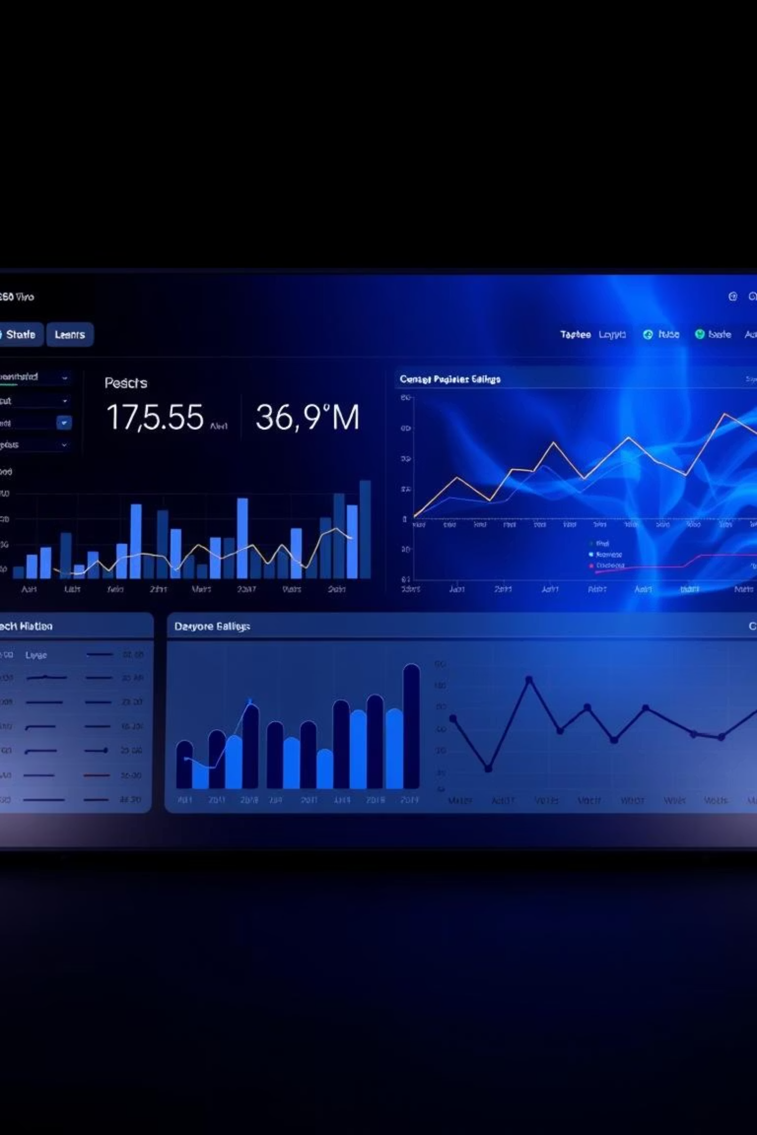
IT TICKET ANALYSIS
Welcome to our deep dive into IT support data. We'll analyze key metrics, identify improvement areas, and recommend strategic investments to enhance service delivery and employee satisfaction.
By Shyam Kumar Kapulaneni

Slide 2
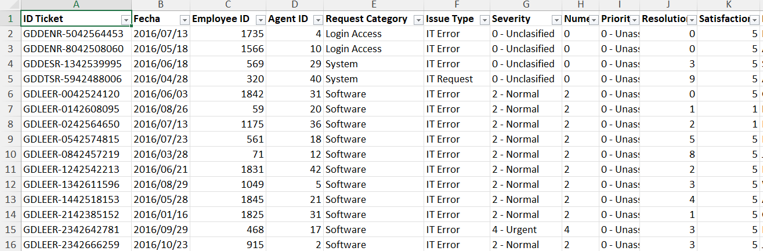
PROBLEM STATEMENT
The objective is to analyze the IT support ticket management system to understand the performance of IT agents, the efficiency of ticket resolution, and the satisfaction levels of employees. The analysis aims to identify high and low performers among IT agents, assess the overall effectiveness of the team, and pinpoint areas for improvement in the ticket resolution process. The ultimate goal is to make informed staffing decisions, including hiring, firing, and training, to enhance overall service quality and team performance.

Slide 3

DATA OVERVIEW
Dataset contains IT support ticket records for analyzing performance.
Each row represents an individual ticket raised by an employee for a specific issue.
The dataset includes key attributes such as:
Ticket ID: Unique identifier assigned to each support request
Data : The date on which ticket was created
Request Category: Type of request (e.g., Login Access, System, Software, Hardware)
Issue Type: Nature of issue (e.g., IT Error, IT Request)
Severity & Priority: Indicates urgency and importance level of ticket.
Resolution Time (Days): Number of days taken to resolve ticket
Satisfaction Rate: Rating provided by users based on service experience

Slide 4
Addressing Data Inconsistencies
Used the date function to obtain the DOB of agents in IT Agents sheet.
Calculated the age of the employees in IT Agents sheet.
Found for duplicate entries, but no duplicates values found.
Column: Severity
Column: Priority
Correction Method
Spelling errors found:
Spelling error found:
Excel's "Check Spelling" feature under the Review Ribbon ensures data integrity.
Unclasified: 356 instances
Unassiged: 29,410 instances
Mayor: 4,836 instances
Correcting these inconsistencies is crucial for accurate analysis and reporting.

Slide 5
DATA ANALYTICAL APPROACH
Data cleaning : Used remove duplicates feature to ensure data accuracy, checked for any missing or blank values using Conditional formatting
Data enrichment : Used VLOOKUP to extract the agents name from the other sheet, using AVERAGE function calculated the average age of employees and also DATE function to format the date
Descriptive Analysis : Employed Pivot tables for summarizing key metrics and identifying patterns
Trend Analysis : Conducted time series analysis using line chart to understand the performance of IT agents over time
Visualization : Created dynamic charts and dashboards for data representation, enabling interactive data exploration

Slide 6
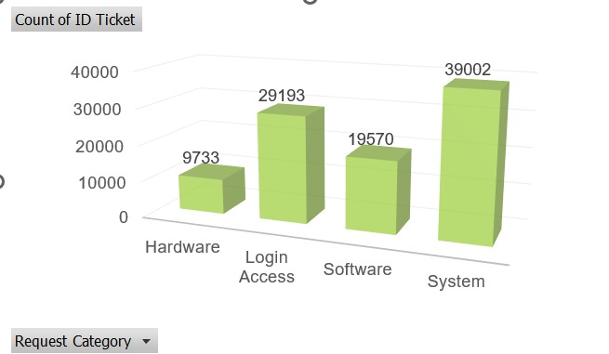
VISUALISATIONS
Ticket Category Distribution
Highest: System (40%)
Lowest: Hardware (10%)
Login Access & Software: 52% combined
These metrics highlight workload and resource allocation needs for IT agents.

Slide 7
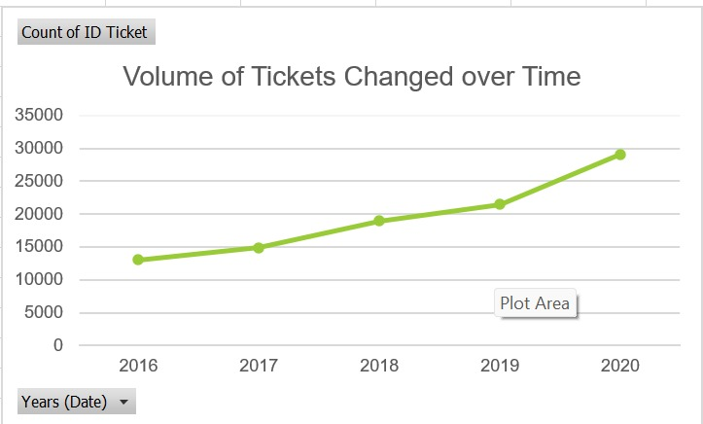
YEARLY TICKETS DISTRIBUTION
Steady growth in ticket volume over the past 5 years
A significant jump in 2020, possibly due to external factors like
remote work shifts during the pandemic.

Slide 8
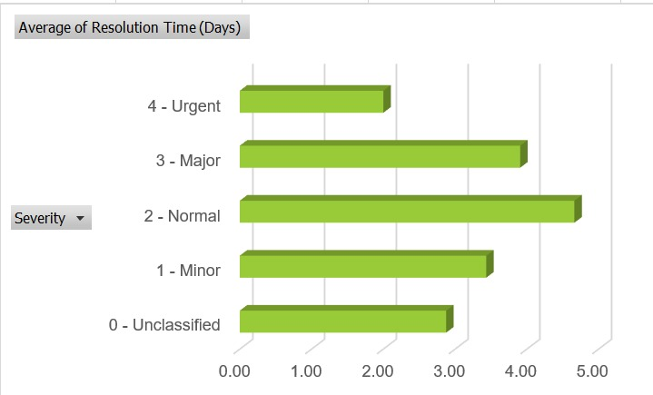
Severity of issues and the resolution time.
The majority of tickets are categorized as Normal severity.
There are a smaller number of Minor severity tickets.
Urgent severity tickets represent a relatively smaller number of tickets
These metrics highlight workload and resource allocation needs for IT agents.

Slide 9

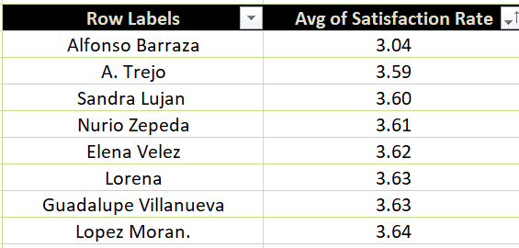
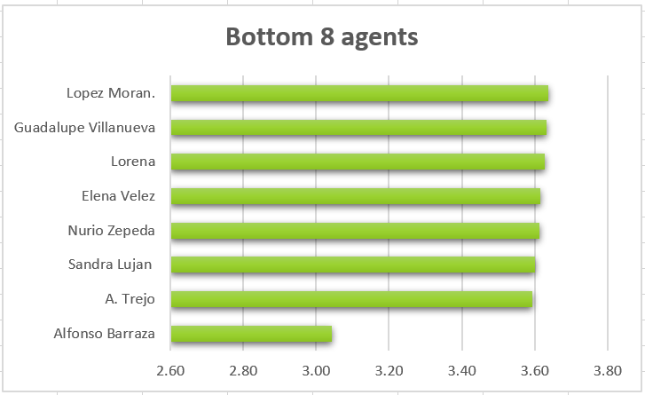
Targeted Agent Training
Identify Underperforming Agents
Filter agents with above-average resolution times and below-average satisfaction ratings.
Agents Identified
Agent ID 25: Longest resolution time
Agent ID 38: Lowest satisfaction rate
Agent ID 12: High resolution, low satisfaction
Training Focus
Improve efficiency and enhance customer satisfaction through targeted skill development.
Personalized training programs are key to elevating overall team performance.

Slide 10
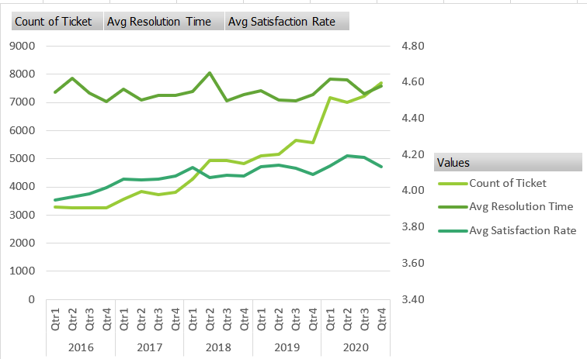
Performance of the IT support team changed over time
Agents Identified
Agent ID 25: Longest resolution time
Agent ID 38: Lowest satisfaction rate
Agent ID 12: High resolution, low satisfaction
Training Focus
Improve efficiency and enhance customer satisfaction through targeted skill development.
Personalized training programs are key to elevating overall team performance.

Slide 11
KEY INSIGHTS DERIVED FROM THE ANALYSIS
Total dataset contains X attributes, with key fields related to tickets, agents, categories, and timestamps.
Data quality issues identified: Missing/inconsistent values found in columns like Email, Category, or Resolution Time, impacting accuracy.
Average daily ticket volume shows fluctuating trends, indicating peak workload periods on specific days/weeks.
Majority of tickets fall under a few categories (e.g., Login Access, System Issues), showing concentration of common problems.
Agent workload is unevenly distributed, with some agents handling significantly higher ticket volumes than others.
Email analysis reveals dominant domains, helping identify internal vs external users.
Certain time periods show spikes in ticket creation, possibly linked to system updates or outages.
Some tickets show long resolution times, indicating potential process inefficiencies.
Total dataset contains X attributes, with key fields related to tickets, agents, categories, and timestamps.
Data quality issues identified: Missing/inconsistent values found in columns like Email, Category, or Resolution Time, impacting accuracy.
Average daily ticket volume shows fluctuating trends, indicating peak workload periods on specific days/weeks.
Majority of tickets fall under a few categories (e.g., Login Access, System Issues), showing concentration of common problems.
Agent workload is unevenly distributed, with some agents handling significantly higher ticket volumes than others.
Email analysis reveals dominant domains, helping identify internal vs external users.
Certain time periods show spikes in ticket creation, possibly linked to system updates or outages.
Some tickets show long resolution times, indicating potential process inefficiencies.

Slide 12
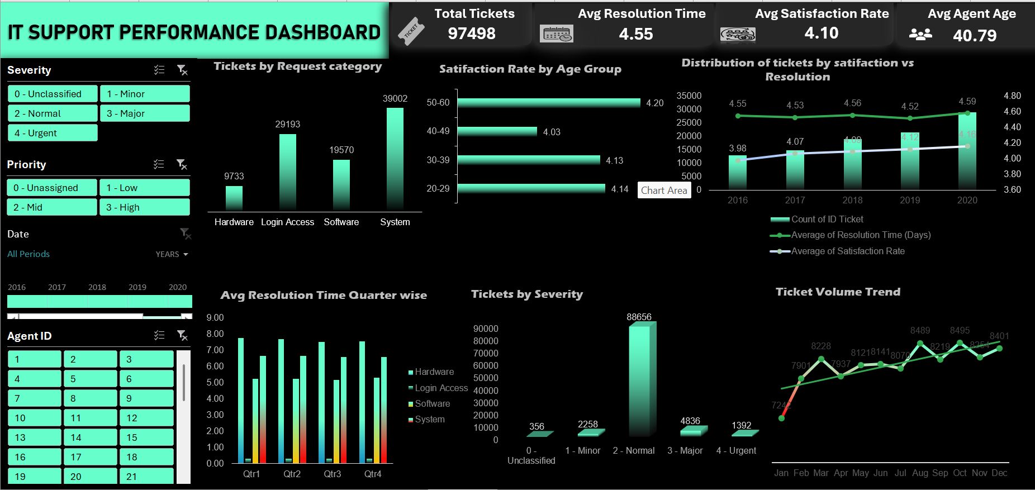
Dashboard for Comprehensive Performance View

Slide 13
CONCLUSION
The ticketing system is functional but requires optimization in workload distribution and data quality.
A small number of issue types drive the majority of tickets, indicating recurring problems.
Agent performance varies, suggesting the need for better task allocation and monitoring.
Data inconsistencies highlight the need for better data validation and entry controls.
Overall, the analysis provides a clear direction for improving efficiency and service quality.

Slide 14
RECOMMENDATIONS
Improve Data Quality
  Implement validation rules for mandatory fields (Email, Category, etc.)
  Regular audits to clean missing/inconsistent data
Optimize Workload Distribution
  Balance tickets among agents using automated assignment rules
  Monitor agent performance using dashboards
Focus on High-Frequency Issues
  Create knowledge base articles for common issues
  Automate solutions for repetitive problems
Reduce Resolution Time
  Set SLA targets and track adherence
  Identify bottlenecks in ticket handling process
Enhance Monitoring & Reporting
  Track daily/weekly ticket trends
Prevent Recurring Issues
  Conduct root cause analysis for frequent categories
  Work with IT teams to fix underlying system problems

Slide 15


